Slide 1
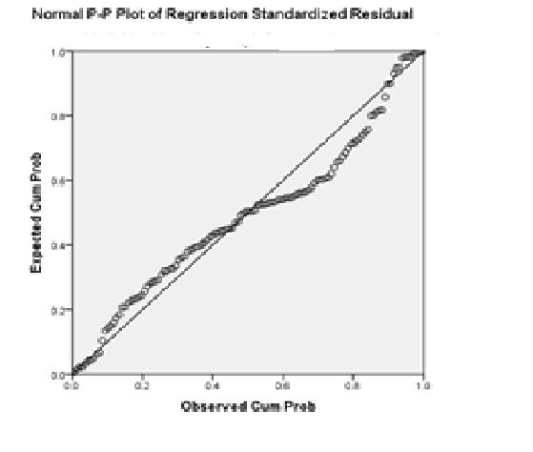
HH
Subjective Happiness Vs Freq of social gathering

